Slide 1
Al-Farabi Kazakh National University
Higher School of Medicine
Department of Fundamental Medicine
Glycomics
Lecturer and creator: PhD Pinsky Ilya Vladimirovich
Notes:
Weaver, PART I

Slide 2
LEARNING OUTCOMES
As a result of the lesson you will be able to:
1. Give the definitions to the following terms: “carbohydrates”, “monosacharids”, “disacharids”, “polysacharids”, “glycome” and “glycomics”, give the specific examples.
2. Analyze the chemical structure and fuctions of different carbohydrates, give the specific examples.
3. Describe the chemical structure and functions of glycoproteins and proteoglycans.
4. Explain how some glycoproteins (lectins) can participate in cellular recognizing, adhesion and interactions between the cells (so called “sugar code”)?
5. Explain different disturbances of carbohydrate metabolism and methods of their diagnostics and treatment, give the specific examples.

Slide 3
Definitions
Glycomics is the comprehensive study of glycomes[1] (the entire complement of sugars, whether free or present in more complex molecules of an organism), including genetic, physiologic, pathologic, and other aspects.[2][3] Glycomics "is the systematic study of all glycan structures of a given cell type or organism" and is a subset of glycobiology.[4] The term glycomics is derived from the chemical prefix for sweetness or a sugar, "glyco-", and was formed to follow the omics naming convention established by genomics (which deals with genes) and proteomics (which deals with proteins).

Slide 4
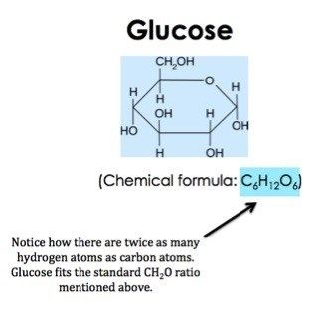
What Are Carbohydrates?
expii.com

Slide 5
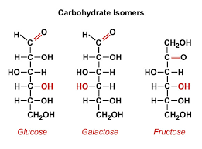
Carbohydrates
dlc.dcccd.edu

Slide 6
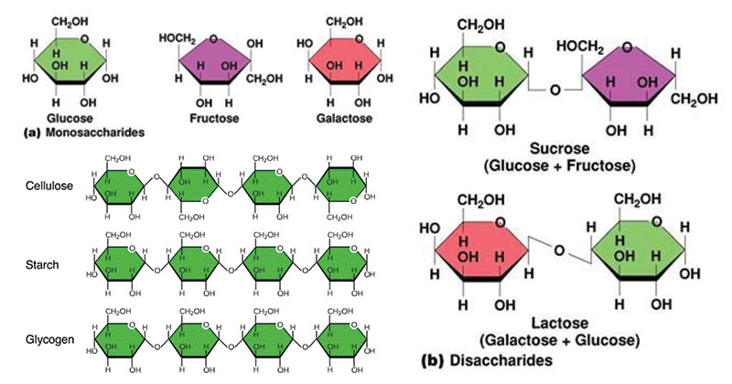
Monosaccharides, Disaccharides, Polysaccharides
microbenotes.com

Slide 7
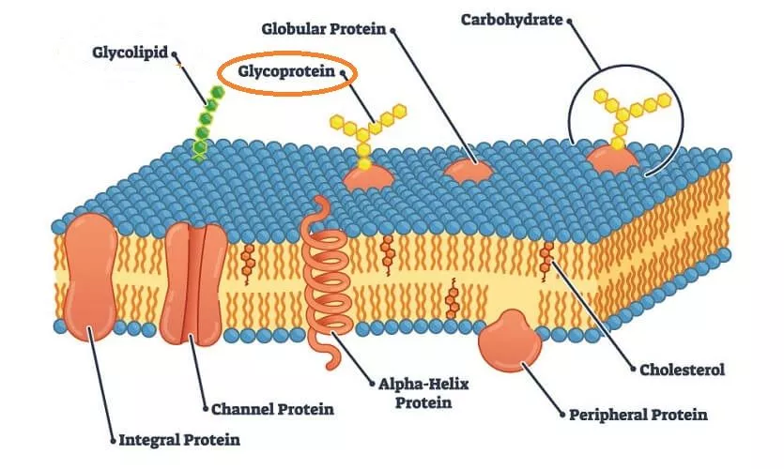
Glycoprotein - The Definitive Guide
biologydictionary.net

Slide 8
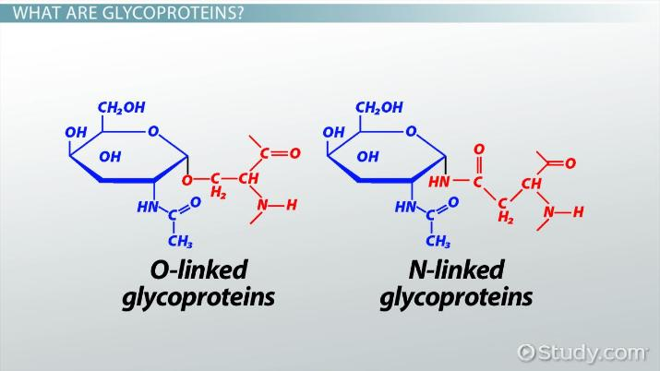
What Are Glycoproteins? – Definition, Functions & Examples
study.com

Slide 9
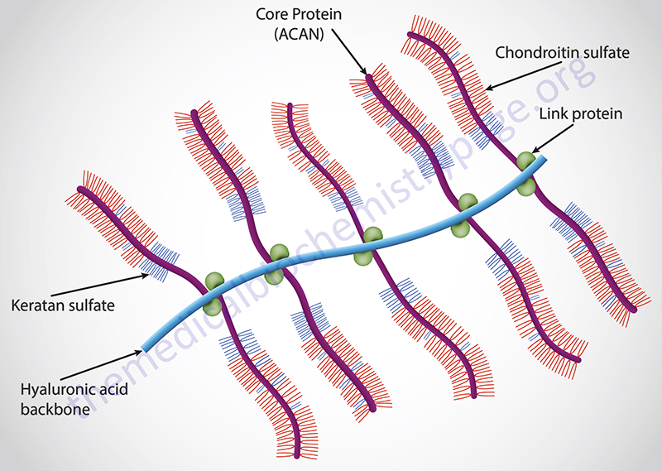
Glycosaminoglycans and Proteoglycans
themedicalbiochemistrypage.org

Slide 10
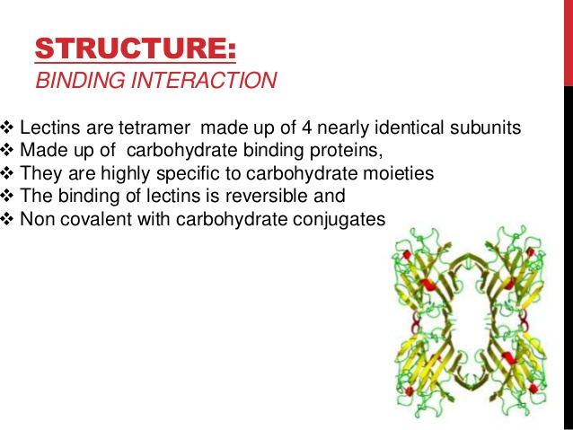
Lectins
slideshare.net

Slide 11
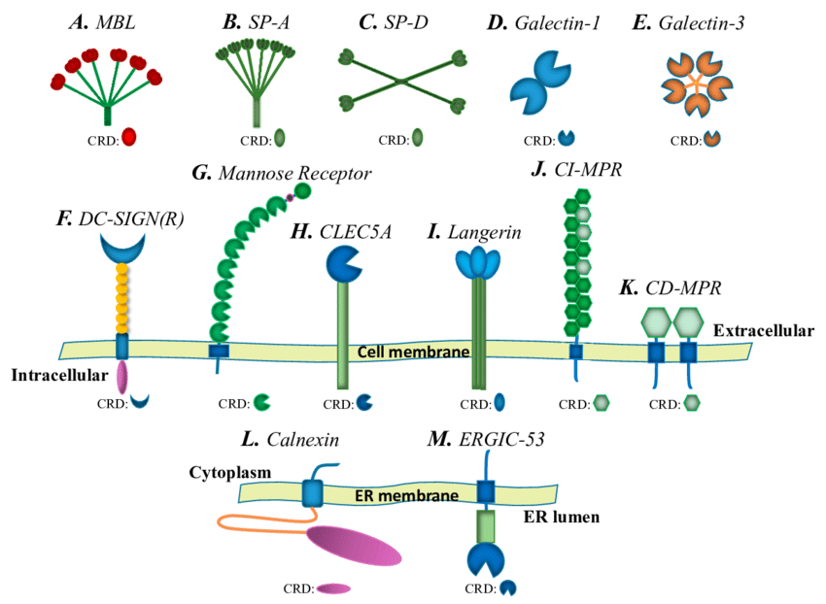
Diagram of lectin structures.
researchgate.net

Slide 12
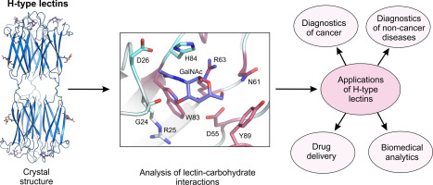
H-type lectins
sciencedirect.com

Slide 13
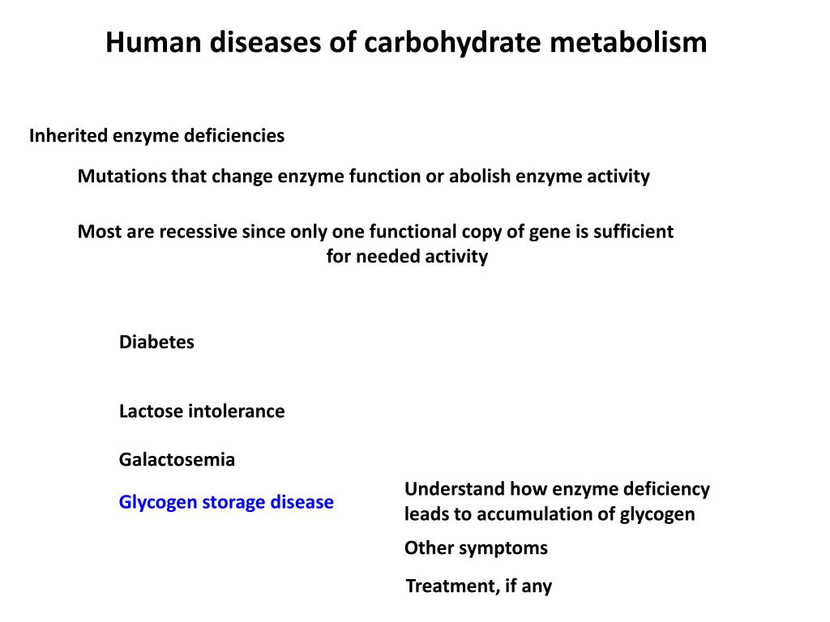
Disorders of carbohydrate metabolism slideserve.com

Slide 14
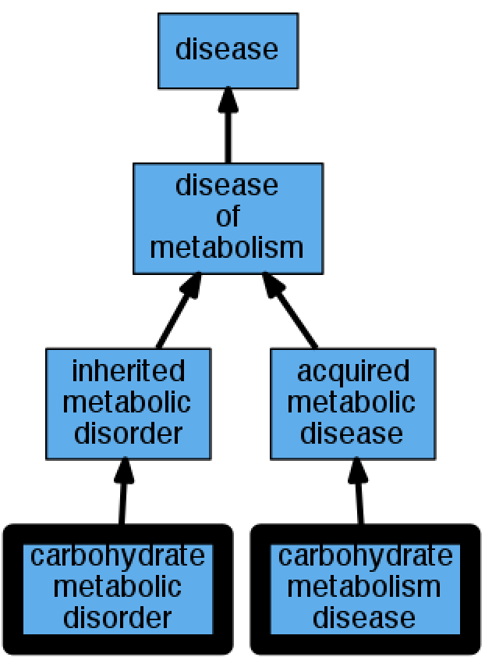
carbohydrate metabolic disorder vs carbohydrate metabolic disease
github.com

Slide 15
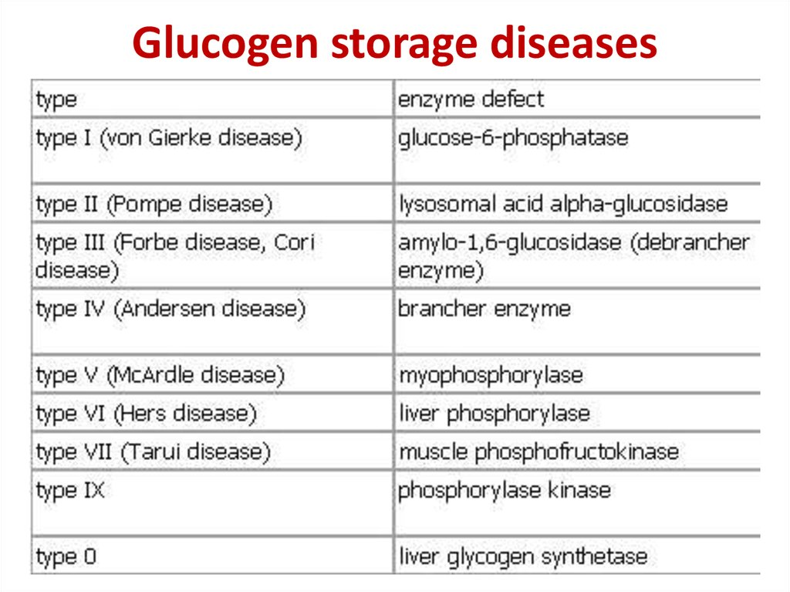
Carbohydrate metabolism
ppt-online.org

Slide 16
References
Rudd, P; Karlsson, NG; Khoo, KH; Packer, NH; Varki, A; Cummings, RD; Esko, JD; Stanley, P; Hart, GW; Aebi, M; Darvill, AG; Kinoshita, T; Packer, NH; Prestegard, JH; Schnaar, RL; Seeberger, PH (2015). "Glycomics and Glycoproteomics". doi:10.1101/glycobiology.3e.051 (inactive 2021-01-18). PMID 28876822.
Aoki-Kinoshita KF; Lewitter, Fran (May 2008). Lewitter, Fran (ed.). "An Introduction to Bioinformatics for Glycomics Research". PLOS Comput. Biol. 4 (5): e1000075. Bibcode:2008PLSCB...4E0075A. doi:10.1371/journal.pcbi.1000075. PMC 2398734. PMID 18516240.
Srivastava S (May 2008). "Move over proteomics, here comes glycomics". J. Proteome Res. 7 (5): 1799. doi:10.1021/pr083696k. PMID 18509903.
Essentials of Glycobiology (2nd ed.). Cold Spring Harbor Laboratory Press. 2009. ISBN 978-087969770-9.

